Slide 1
Creating Page Layouts with CSS
Designing a Web Site for a Cycling Club

Slide 2
Case: Cycle Pathology
Dan Atwood is a cyclist who lives and works in Grand Junction, Colorado. About 30 years ago, he and a few friends started a cycling group called Cycle Pathology. At the beginning, the group’s activities consisted of weekend rides through the western Colorado countryside. However, with the growth in the popularity of cycling, the group has expanded to several hundred active members and now organizes rides and tours for much of western Colorado.
To keep current and potential members informed about future rides and events, Dan created the Cycle Pathology Web site in the late 1990s. With the growth of the group, he has decided to redesign the site and has asked you for help in planning a new layout and design.

Slide 3
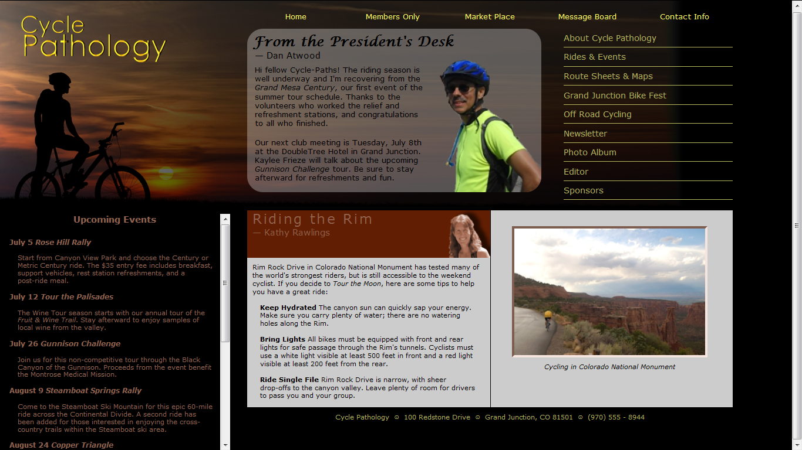

Slide 4
Starting data files
Use your text editor to open the cycletxt.htm file from the tutorial.04/tutorial folder. Enter your name and the date in the comment section of the file, and then save it as cycle.htm.
Take some time to review the content and structure of the cycle.htm file in your text editor.
Open the cycle.htm file in your Web browser. Figure in next slide shows the current appearance of part of the page using one browser’s internal style sheet.

Slide 5
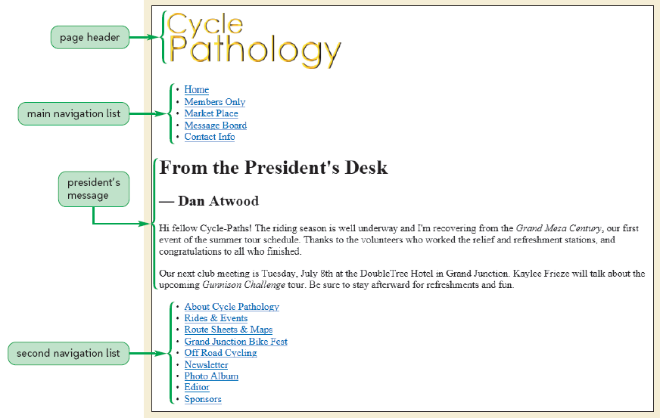

Slide 6
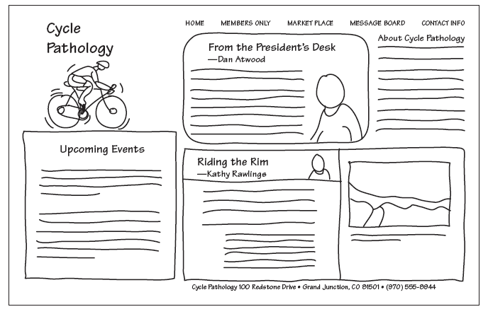
Cycle Pathology layout design

Slide 7
The display style: create the reset style sheet
Use your text editor to open the cp_resettxt.css file from the tutorial.04/tutorial folder. Enter your name and the date in the comment section of the file and then save it as cp_reset.css.
Below the comment section, add the following comment and style rule:
/* Display HTML5 structural elements as blocks */
article, aside, figure, figcaption, footer, hgroup, header, section, nav {
display: block;
}
Save your changes to the file.

Slide 8
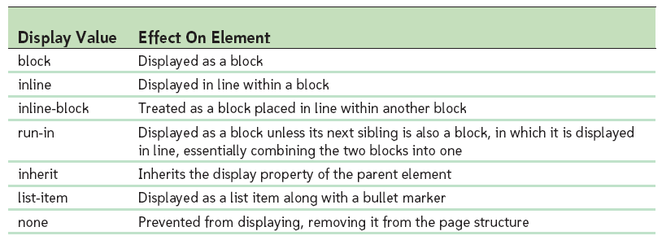
Values of the display property

Slide 9
Set the default styles for the Web site
Below the style rule you just created in the cp_reset.css file, enter the following rule:
/* Set the default page element styles */
body * {
font-family: Verdana, Geneva, sans-serif;
font-size: 100%;
font-weight: inherit;
line-height: 1.2em;
list-style: none;
vertical-align: baseline;
}
Save your changes to the file.

Slide 10
Hide the different sections of the page
At the bottom of the cp_reset.css style sheet, enter the following style rule:
/* Temporarily hide the page sections */
nav.horizontalNAV, #president, nav.verticalNAV, #story, header, aside, footer
{
display: none;
}
Save your changes to the file and then return to the cycle.htm file in your text editor
Directly above the closing </head> tag, insert the following link to the reset style sheet:
<link href=”cp_reset.css” rel=”stylesheet” />
Save your changes to the file and then reload the cycle.htm file in your Web browser. Verify that no content is displayed in the browser window.

Slide 11
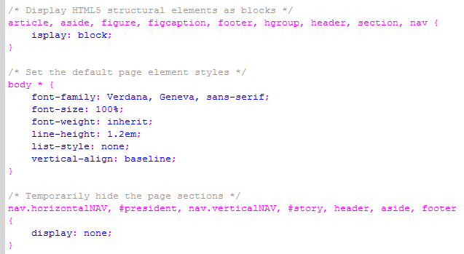

Slide 12
Format the page background
Open the cp_stylestxt.css file in your text editor. Type your name and the date in the comment section at the top of the file, and then save the file as cp_styles.css.
Below the comment section, insert the following style rule:
/* Styles for the Page Body */
body {
background: black url(bike_bg.png) top left no-repeat;
}
Save your changes to the file and then return to the cycle.htm file in your text editor.
Directly below the link element for the cp_reset.css style sheet, insert the following:
<link href=”cp_styles.css” rel=”stylesheet” />
Save your changes to the file and then reload the cycle.htm file.

Slide 13
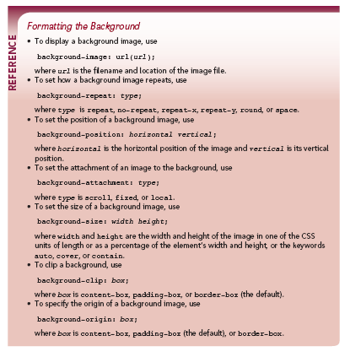

Slide 14
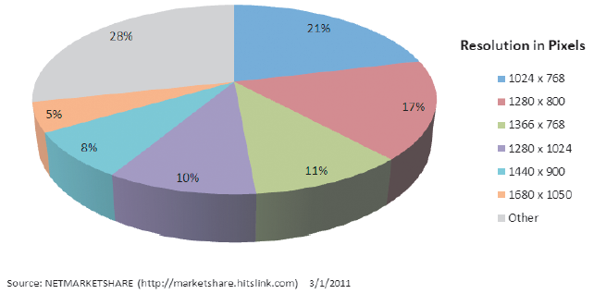
Exploring Layout Designs: Screen resolutions on the Web

Slide 15
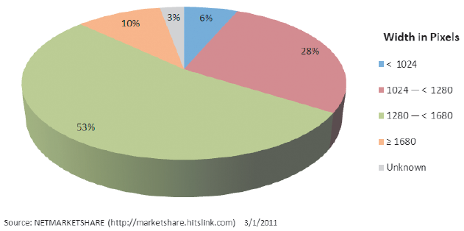
Exploring Layout Designs: Screen width on the Web

Slide 16
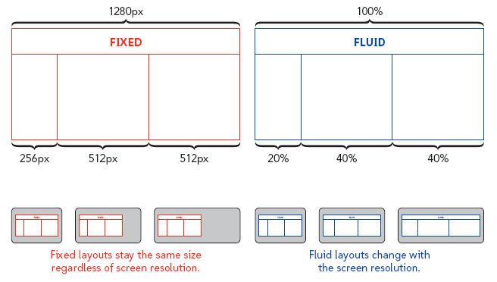
Fixed and fluid layouts

Slide 17
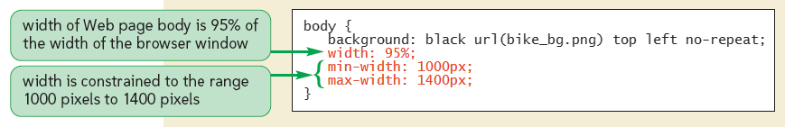
Set the page width
Return to the cp_styles.css style sheet in your text editor.
Within the style rule for the body element, insert the following properties:
width: 95%;
min-width: 1000px;
max-width: 1400px;
Save your changes to the file.

Slide 18
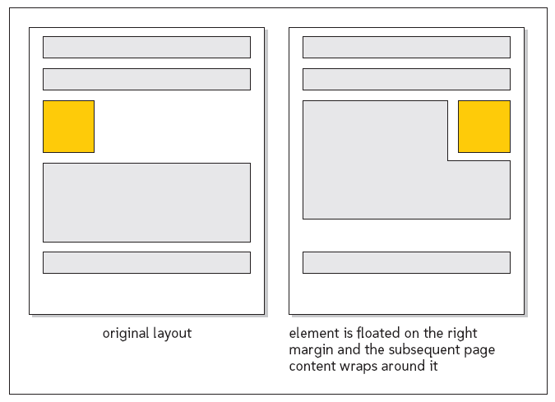
Setting a Float
Floating an element takes that element out of the normal flow of the document and positions it along the left or right edge of its containing element. Subsequent elements that are not floated are then moved up to occupy the position previously occupied by the floating element.

Slide 19
Format the navigation list
Return to the cp_styles.css style sheet in your text editor.
Below the style rule for the body selector, add the following code:
/* General Navigation List Style */
nav a {
text-decoration: none;
}
/* Horizontal Navigation List */
nav.horizontalNAV li {
font-size: 87.5%;
float: left;
text-align: center;
width: 20%;
}
nav.horizontalNAV li a {
color: rgb(255, 255, 99);
}
nav.horizontalNAV li a:hover {
color: white;
}

Slide 20
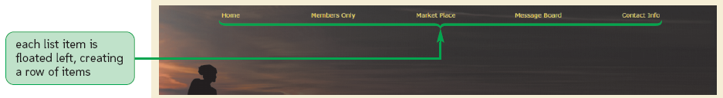
Save your changes to the file.
Next, you’ll change the reset style sheet rules so that the horizontal navigation list is once again displayed.
Return to the cp_reset.css style sheet in your text editor and then scroll down to the style rule at the bottom of the page. Remove the selector nav.horizontalNAV along with the comma separator that follows it from the start of the selector list.
Save your changes to the reset style sheet and then reload cycle.htm in your Web browser. The hypertext links are now rendered in a single row across the top of the page.
Verify that the color of each link changes to white in response to the hover event.

Slide 21
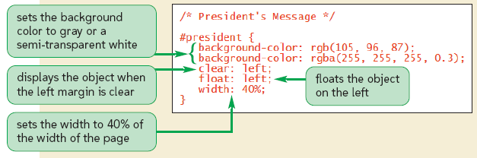
Format the navigation list
Return to the cp_styles.css style sheet in your text editor, and then at the bottom of the style sheet, insert the following rule:
/* President's message */
#president {
background-color: rgb(105, 96, 87);
background-color: rgba(255, 255, 255, 0.3);
clear: left;
float: left;
width: 40%;
}
Save your changes to the file. Now re-display the president’s message.
Return to the cp_reset.css style sheet in your text editor. Remove the selector #president and the comma that follows it from the start of the selector list in the style rule at the bottom of the file. Save your changes. Reload the cycle.htm file in your Web browser.

Slide 22
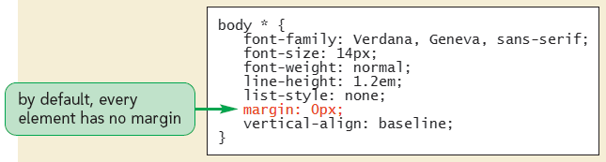
Define the default margin size
Return to the cp_reset.css style sheet file in your text editor.
Locate the style rule that defines the default page element styles and add the following style property:
margin: 0px;
Save your changes to the file.

Slide 23
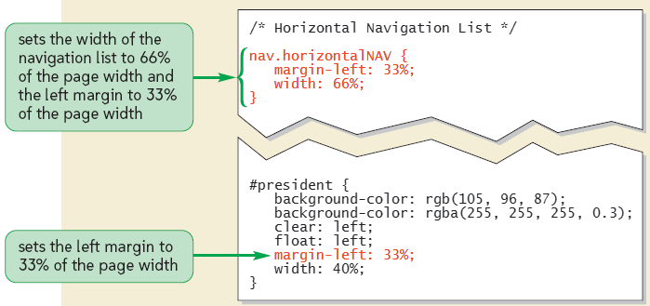
Change the margin spaces in the page
Return to the cp_styles.css style sheet file in your text editor, and then directly below the comment Horizontal Navigation List add the following style rule:
nav.horizontalNAV {
margin-left: 33%;
width: 66%;
}
Scroll down to the style rule for the president’s message and add the following style: margin-left: 33%;
Save your changes to the file and then reload cycle.htm in your Web browser.

Slide 24
Modify the padding size
Return to the cp_reset.css style sheet file in your text editor. Within the style rule for default page styles, add the following property:
padding: 0px;
Save your changes to the file and return to the cp_styles.css file in your text editor. Within the style rule for list items in the horizontal navigation list, add the following style:
padding: 15px 0px;
This style sets the top and bottom padding space to 15 pixels, and the right and left padding space to 0 pixels.
Save your changes to the file and then reload cycle.htm in your Web browser. Verify that additional space has been added above and below the horizontal navigation list.

Slide 25
Format the headings in the president’s message:
Return to the cp_styles.css style sheet file in your text editor.
Add the following style rule at the bottom of the file to display the h1 heading in the president’s message in a bold cursive-style font that is 158% of the size of the default text, with 10-pixel margins above and to the left of the text content:
#president h1 {
font-family: 'Lucida Calligraphy', 'Apple Chancery', cursive;
font-size: 158%;
font-weight: bold;
margin: 10px 0px 0px 10px;
}
Below that style rule, add the following style rule to display the h2 heading in the president’s message in a font size that is 105% of the size of the default text, with a 10-pixel margin below the text and a 15-pixel margin to the left of the text:
#president h2 {
font-size: 105%;
margin: 0px 0px 10px 15px;
}
Save your changes to the file.

Slide 26
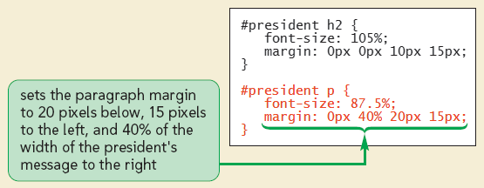
Add the background image:
At the bottom of the cp_styles.css file, insert the following style rule to set the paragraph font size and margins:
#president p {
font-size: 87.5%;
margin: 0px 40% 20px 15px;
}
In this case, the margins are a mixture of absolute and relative lengths. The top, bottom, and left margins are set to 0 pixels, 20 pixels, and 15 pixels, respectively. The size of the right margin will depend on the size of the president’s box, which in turn will vary depending on the width of the Web page.

Slide 27
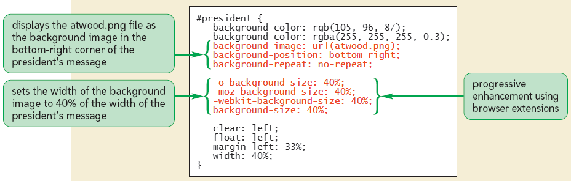
Add the following properties to the #president selector style rule to define the source, position, tiling, and size of the background image:
background-image: url(atwood.png);
background-position: bottom right;
background-repeat: no-repeat;
-o-background-size: 40%;
-moz-background-size: 40%;
-webkit-background-size: 40%;
background-size: 40%;
Notice that the style rule uses progressive enhancement and vendor prefixes in order to provide support for the widest range of browsers and browser versions. Save your changes to the file and then reload cycle.htm.

Slide 28
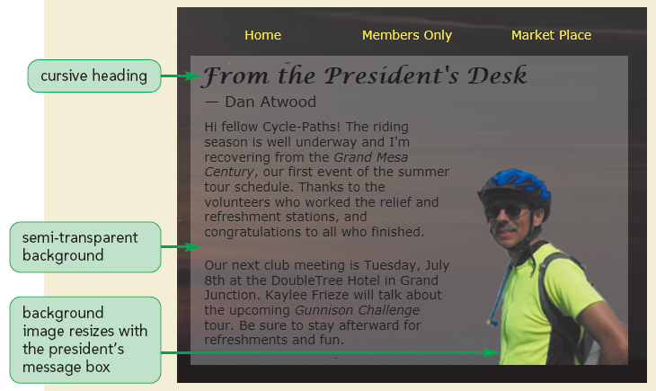

Slide 29
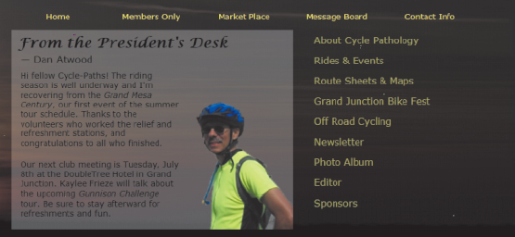
Redisplay the vertical navigation list
Return to the cp_reset.css style sheet in your text editor and remove the selector nav.verticalNAV and the comma that follows it from the last style rule. Save your changes to the file.
Go to the cp_styles.css style sheet in your text editor. At the bottom of the file, insert the following style rules to format the vertical navigation list:
/* Vertical Navigation List */
nav.verticalNAV {
float: left;
margin-left: 3%;
width: 23%;
}
nav.verticalNAV a {
color: rgb(182, 182, 92);
line-height: 2.2em;
}
Save your changes to the file and then reload cycle.htm in your browser.

Slide 30
Add a bottom border to the hypertext links
Return to the cp_styles.css file in your text editor.
Within the style rule for the nav.verticalNAV a selector, add the following styles in alphabetical order within the curly braces as:
border-bottom: 1px solid rgb(182, 182, 92);
display: block;
At the bottom of the file, add the following style rule to change the background color of the hyperlinks in the vertical navigation list in response to the hover event:
nav.verticalNAV a:hover {
background-color: rgb(105, 96, 87);
background-color: rgba(255, 255, 255, 0.3);
}
Save your changes to the file and reload cycle.htm in your Web browser. Verify that the hyperlinks now display a bottom border with the hover effect.

Slide 31
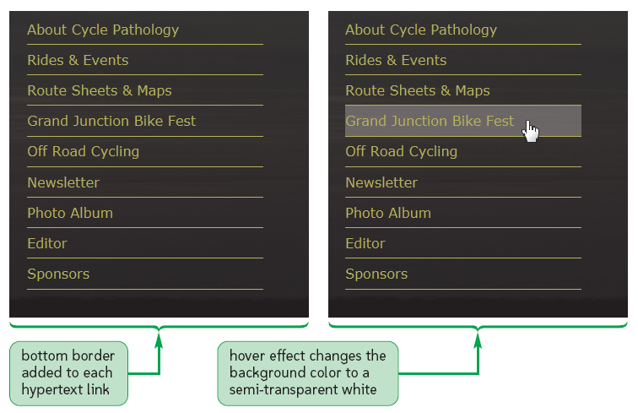

Slide 32
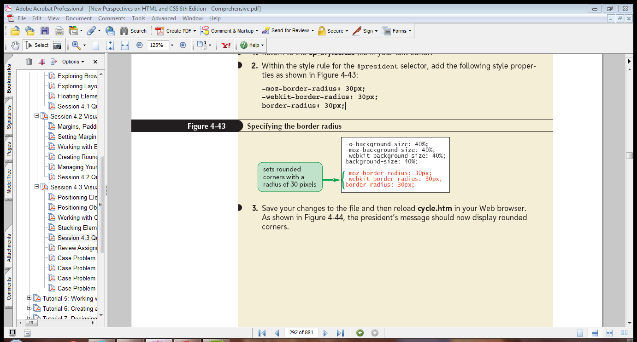
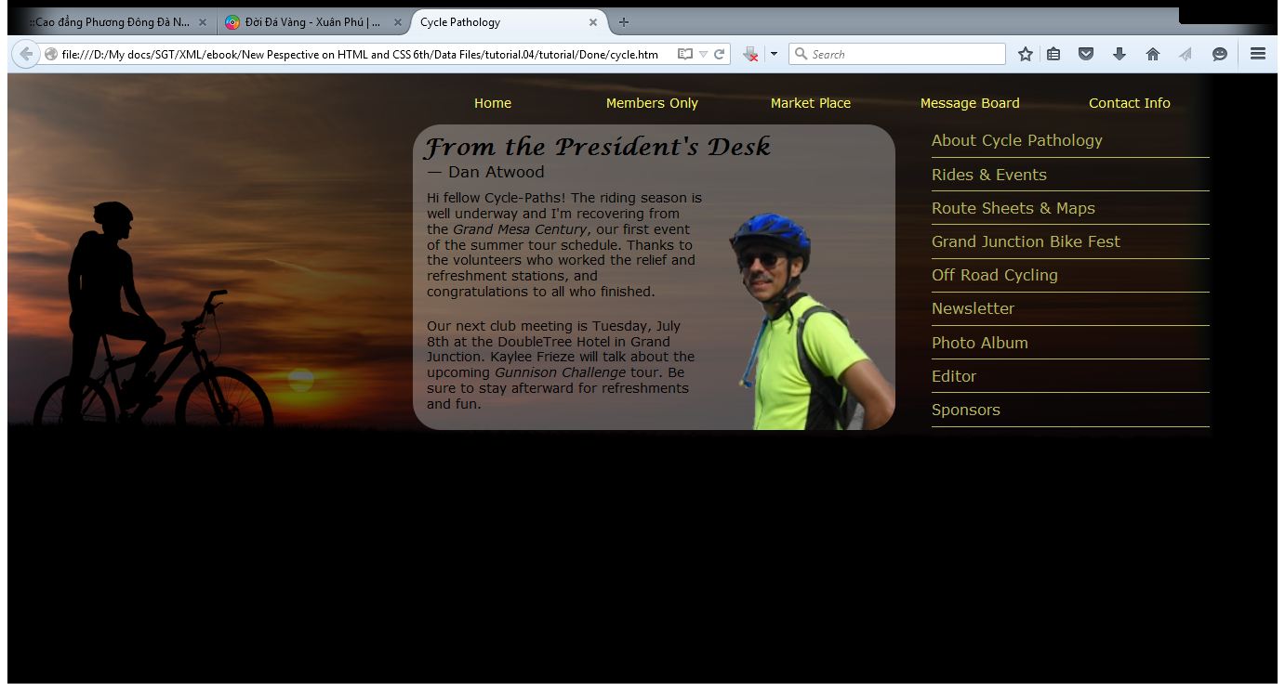
Create rounded corners
Return to the cp_styles.css file in your text editor.
Within the style rule for the #president selector, add the following style properties:
-moz-border-radius: 30px;
-webkit-border-radius: 30px;
border-radius: 30px;
Save your changes to the file and then reload cycle.htm in your Web browser. The president’s message should now display rounded corners.

Slide 33
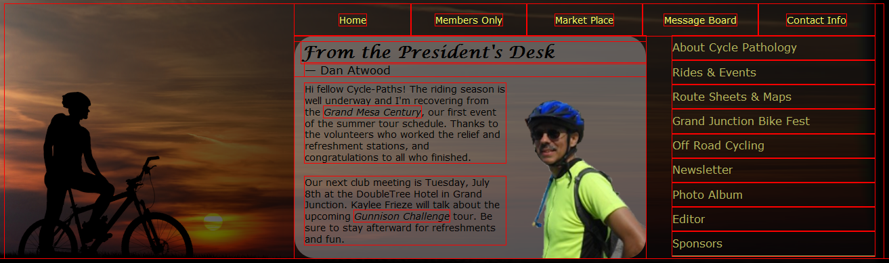
View the layout structure
Return to the cp_styles.css file in your text editor.
At the bottom of the file, insert the following style rule:
* { outline: 1px solid red; }
Save your changes to the file and then reload cycle.htm in your Web browser. Each element in the page is outlined in red, showing its exact width, height, and location under your current design.
Return to the cp_styles.css file in your text editor and remove the style rule you created in Step 2. Save your changes to the file.

Slide 34
Display the story section
Return to the cp_reset.css file in your text editor and then go to the style rule at the bottom of the file that hides page elements. Remove the selector #story and the comma that follows it from the style rule, and then save your changes to the file.
Return to the cp_styles.css file in your style sheet.
At the bottom of the file, add the following style rule to align the story section directly below the president’s message, separated by a 20-pixel vertical margin:
/* Story section styles */
#story {
background-color: gray;
background-color: rgba(255, 255, 255, 0.8);
clear: left;
float: left;
margin: 20px 0px 0px 33%;
width: 66%;
}

Slide 35
Below the style rule you just added, add the following two style rules to float the article and figure box side-by-side, with each one taking up about half of the width of the story section:
/* Article styles */
#story article {
border-right: 1px solid black;
float: left;
width: 50%;
}
/* Figure box styles */
#story figure {
float: left;
width: 49%;
}
Save your changes to the file and then reload cycle.htm in your Web browser. The placement of the story section as well as the Rim Rock Drive article and figure box within it.

Slide 36
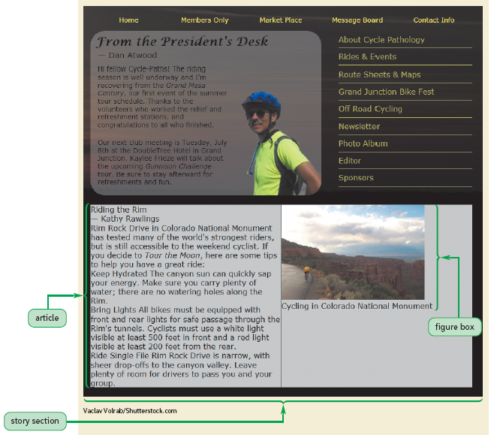

Slide 37
Format the article heading
Return to the cp_styles.css file in your text editor. Directly below the style rule for the story article selector, insert the following rules to format the size, background, and text of the article heading group:
#story article hgroup {
background: rgb(97, 30, 2) url(rawlings.png) bottom right no-repeat;
-o-background-size: contain;
-moz-background-size: contain;
-webkit-background-size: contain;
background-size: contain;
color: rgb(145, 98, 78);
color: rgba(255, 255, 255, 0.3);
height: 90px;
text-indent: 10px;
}

Slide 38
Set the size of the h1 heading in the article to 158% of the default font size, and set the kerning to 3 pixels by adding the following rule directly below the rule you created in Step 1:
#story article hgroup h1 {
font-size: 158%;
letter-spacing: 3px;
}
Finally, set the size of the h2 headings to 105% of the default font size by adding the following style rule directly below the rule you created in Step 2:
#story article hgroup h2 {
font-size: 105%;
}
Save your changes to the file and reload cycle.htm in your Web browser.

Slide 39
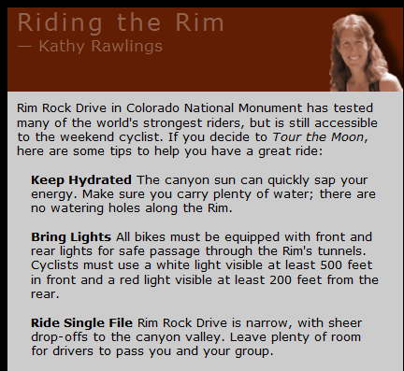
Format the paragraph and list items
Return to the cp_styles.css file in your text editor. Directly below the style rule for the h2 heading you created in the last set of steps, add the following rules:
#story article p {
font-size: 80%;
margin: 10px;
}
#story article ul li {
font-size: 80%;
margin: 15px 25px;
}
#story article ul li strong {
font-weight: bold;
}
Save your changes and reload cycle.htm in your Web browser. The final format of the article heading and text.

Slide 40
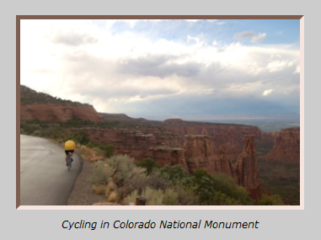
Format the figure box
Return to the cp_styles.css file in your text editor. At the bottom of the style sheet, insert the following rules:
#story figure img {
border: 5px inset rgb(227, 168, 145);
display: block;
margin: 30px auto 10px;
width: 80%;
}
#story figure figcaption {
font-size: 75%;
font-style: italic;
text-align: center;
}
Save your changes and then reload cycle.htm in your Web browser.

Slide 41
Place the page header
Return to the cp_reset.css file in your text editor and remove the selector header and the comma that follows it from the style rule at the bottom of the file that hides the page elements. Save your changes to the file.
Go to the cp_styles.css file in your text editor. Directly below the style rule for the body selector near the top of the page, insert the following style rule:
/* Styles for the Page Header */
header {
position: absolute;
top: 20px;
left: 20px;
}
Save your changes to the file and then reload cycle.htm in your Web browser. The graphic image for the Cycle Pathology logo appears in the top-left corner of the browser window.

Slide 42
Place the sidebar
Go to the cp_reset.css file in your text editor and remove the selector aside and the comma that follows it from the style rule at the bottom of the file, leaving only the footer selector. Save your changes to the file.
Return to the cp_styles.css file in your text editor. At the bottom of the file, insert the following style rule to place the aside element halfway down the left edge of the page:
/* Sidebar styles */
aside {
color: rgb(145, 98, 78);
position: absolute;
top: 400px;
left: 10px;
width: 30%;
}
Save your changes to the file and then reload cycle.htm in your Web browser. The sidebar describing the upcoming rides starts halfway down the left edge of the page.

Slide 43
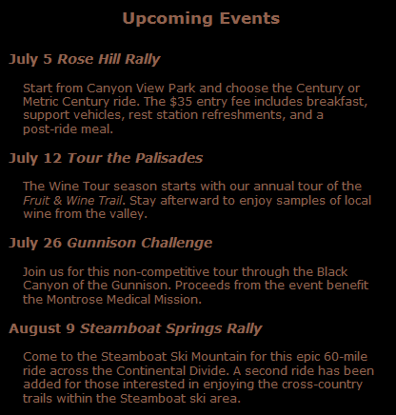
Format the sidebar content
Return to the cp_styles.css file in your text editor. At the bottom of the file, insert the following style rules for the h1, h2, and p elements in the aside element:
aside h1 {
font-size: 105%;
font-weight: bold;
margin-bottom: 25px;
text-align: center;
}
aside h2 {
font-size: 85%;
font-weight: bold;
}
aside p {
font-size: 75%;
margin: 15px;
}
Save your changes to the file and then reload cycle.htm in your Web browser.

Slide 44
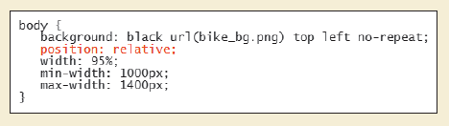
Position the entire page body
Return to the cp_styles.css file and locate the style rule for the body selector near the top of the page.
Add the following property to the style rule: position: relative;
Save your changes to the file and then reload the cycle.htm file in your Web browser. Change the size of your browser window and verify that the width of the aside element changes proportionally along with the widths of the other page elements.

Slide 45
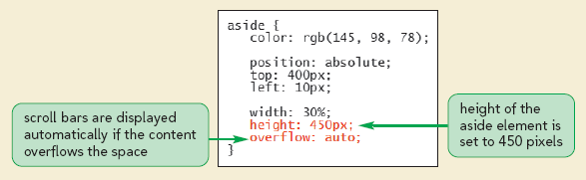
Define the overflow style for the aside element
Return to cp_styles.css in your text editor and scroll down the style rule for the aside selector near the bottom of the file.
Add the following styles:
height: 450px;
overflow: auto;
Save your changes to the file and then reload cycle.htm in your Web browser. A scroll bar is added to the aside element.

Slide 46
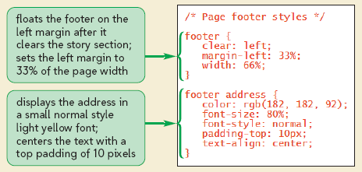
Style the page footer and address
Go to the cp_reset.css file in your text editor. Scroll to the bottom of the file and delete the footer selector, along with its style comment. Saving your changes.
Return to the cp_styles.css file in your text editor. At the bottom of the file, insert the following style rules for the page footer:
/* Page footer styles */
footer {
clear: left;
margin-left: 33%;
width: 66%;
}
Below the footer, add style rule for the address element:
footer address {
color: rgb(182, 182, 92);
font-size: 80%;
font-style: normal;
padding-top: 10px;
text-align: center; }

